Slide 1
CS 343: Artificial Intelligence
Probabilistic Reasoning and
Naïve Bayes
Raymond J. Mooney
University of Texas at Austin

Slide 2
Need for Probabilistic Reasoning
Most everyday reasoning is based on uncertain evidence and inferences.
Classical logic, which only allows conclusions to be strictly true or strictly false, does not account for this uncertainty or the need to weigh and combine conflicting evidence.
Straightforward application of probability theory is impractical since the large number of probability parameters required are rarely, if ever, available.
Therefore, early expert systems employed fairly ad hoc methods for reasoning under uncertainty and for combining evidence.
Recently, methods more rigorously founded in probability theory that attempt to decrease the amount of conditional probabilities required have flourished.

Slide 3
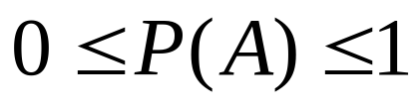

Axioms of Probability Theory
All probabilities between 0 and 1
True proposition has probability 1, false has probability 0.
P(true) = 1 P(false) = 0.
The probability of disjunction is:
A
B

Slide 4
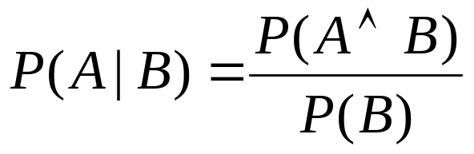
Conditional Probability
P(A | B) is the probability of A given B
Assumes that B is all and only information known.
Defined by:
A
B

Slide 5


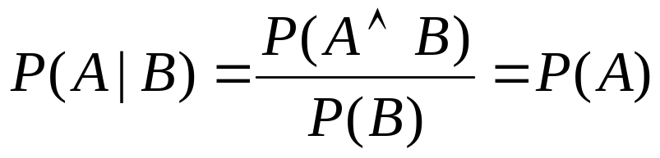
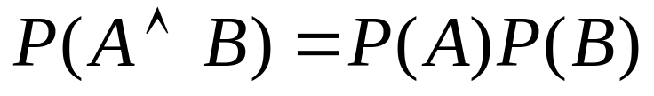
Independence
A and B are independent iff:
Therefore, if A and B are independent:
These two constraints are logically equivalent

Slide 6
Classification (Categorization)
Given:
  A description of an instance, x∈X, where X is the instance language or instance space.
  A fixed set of categories: C={c₁, c₂,…c_{n}}
Determine:
  The category of x: c(x)∈C, where c(x) is a categorization function whose domain is X and whose range is C.
  If c(x) is a binary function C={0,1} ({true,false}, {positive, negative}) then it is called a concept.

Slide 7
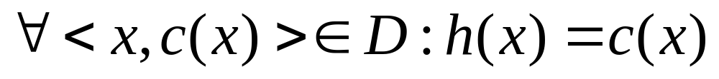
Learning for Categorization
A training example is an instance x∈X, paired with its correct category c(x): <x, c(x)> for an unknown categorization function, c.
Given a set of training examples, D.
Find a hypothesized categorization function, h(x), such that:
Consistency

Slide 8
Sample Category Learning Problem
Instance language: <size, color, shape>
  size ∈ {small, medium, large}
  color ∈ {red, blue, green}
  shape ∈ {square, circle, triangle}
C = {positive, negative}
D:
Example | Size | Color | Shape | Category
1 | small | red | circle | positive
2 | large | red | circle | positive
3 | small | red | triangle | negative
4 | large | blue | circle | negative

Slide 9
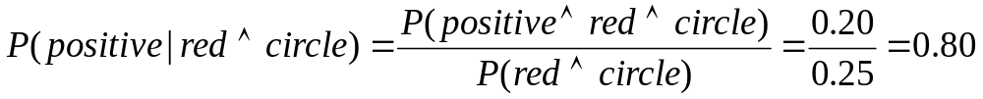
Joint Distribution
The joint probability distribution for a set of random variables, X₁,…,X_{n} gives the probability of every combination of values (an n-dimensional array with v^{n} values if all variables are discrete with v values, all v^{n} values must sum to 1): P(X₁,…,X_{n})
The probability of all possible conjunctions (assignments of values to some subset of variables) can be calculated by summing the appropriate subset of values from the joint distribution.
Therefore, all conditional probabilities can also be calculated.
positive
negative
 | circle | square
red | 0.20 | 0.02
blue | 0.02 | 0.01
 | circle | square
red | 0.05 | 0.30
blue | 0.20 | 0.20

Slide 10
Probabilistic Classification
Let Y be the random variable for the class which takes values {y₁,y₂,…y_{m}}.
Let X be the random variable describing an instance consisting of a vector of values for n features <X₁,X₂…X_{n}>, let x_{k} be a possible value for X and x_{ij} a possible value for X_{i.}
For classification, we need to compute P(Y=y_{i} | X=x_{k}) for i=1…m
However, given no other assumptions, this requires a table giving the probability of each category for each possible instance in the instance space, which is impossible to accurately estimate from a reasonably-sized training set.
  Assuming Y and all X_{i} are binary, we need 2^{n} entries to specify P(Y=pos | X=x_{k}) for each of the 2^{n} possible x_{k}’s since P(Y=neg | X=x_{k}) = 1 – P(Y=pos | X=x_{k})
  Compared to 2^{n+1} – 1 entries for the joint distribution P(Y,X₁,X₂…X_{n})

Slide 11
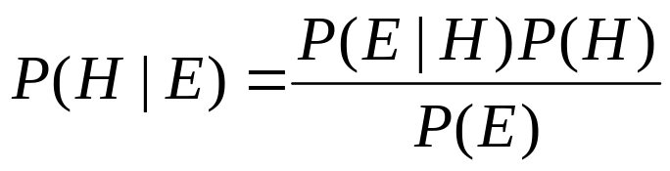
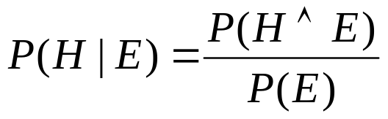
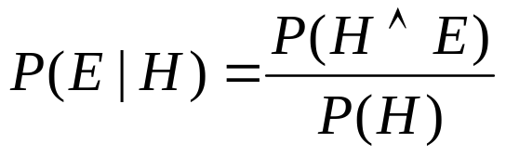

Bayes Theorem
Simple proof from definition of conditional probability:
(Def. cond. prob.)
(Def. cond. prob.)
QED:

Slide 12
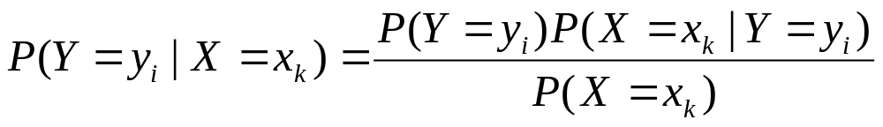
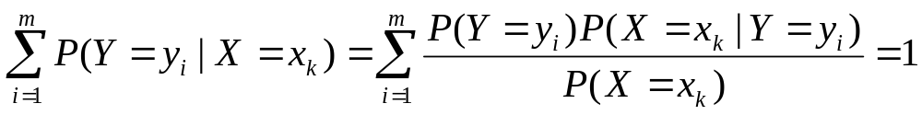
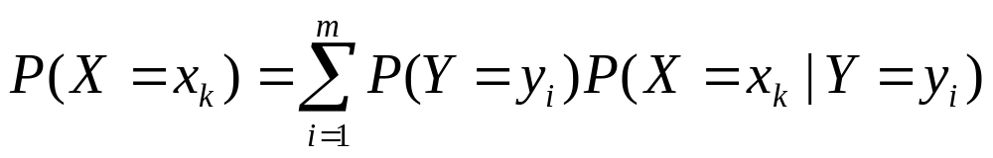
Bayesian Categorization
Determine category of x_{k} by determining for each y_{i}
P(X=x_{k}) can be determined since categories are complete and disjoint.

Slide 13
Bayesian Categorization (cont.)
Need to know:
  Priors: P(Y=y_{i})
  Conditionals: P(X=x_{k} | Y=y_{i})
P(Y=y_{i}) are easily estimated from data.
  If n_{i} of the examples in D are in y_{i} then P(Y=y_{i}) = n_{i} / |D|
Too many possible instances (e.g. 2^{n} for binary features) to estimate all P(X=x_{k} | Y=y_{i}).
Still need to make some sort of independence assumptions about the features to make learning tractable.

Slide 14
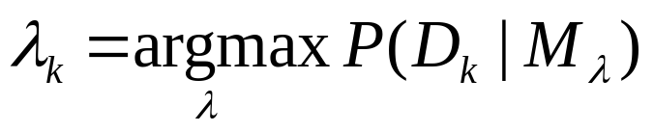
Generative Probabilistic Models
Assume a simple (usually unrealistic) probabilistic method by which the data was generated.
For categorization, each category has a different parameterized generative model that characterizes that category.
Training: Use the data for each category to estimate the parameters of the generative model for that category.
  Maximum Likelihood Estimation (MLE): Set parameters to maximize the probability that the model produced the given training data.
  If M_{λ} denotes a model with parameter values λ and D_{k} is the training data for the kth class, find model parameters for class k (λ_{k}) that maximize the likelihood of D_{k}:
Testing: Use Bayesian analysis to determine the category model that most likely generated a specific test instance.

Slide 15
Naïve Bayes Generative Model
neg
pos
pos
pos
neg
pos
neg
Category
med
red
circ
lg
red
circ
sm
blue
tri
tri
sm
blue
sqr
med
lg
red
grn
red
circ
med
med
grn
grn
tri
circ
lg
lg
sm
blue
circ
circ
sm
lg
red
blue
circ
tri
sqr
sm
med
red
red
circ
sqr
sm
lg
blue
grn
sqr
tri
Size Color Shape
Size Color Shape
Positive
Negative

Slide 16
Naïve Bayes Inference Problem
lg red circ
?? ??
neg
pos
pos
pos
neg
pos
neg
Category
med
red
circ
lg
red
circ
sm
blue
tri
tri
sm
blue
sqr
med
lg
red
grn
red
circ
med
med
grn
grn
tri
circ
lg
lg
sm
blue
circ
circ
sm
lg
red
blue
circ
tri
sqr
sm
med
red
red
circ
sqr
sm
lg
blue
grn
sqr
tri
Size Color Shape
Size Color Shape
Positive
Negative

Slide 17
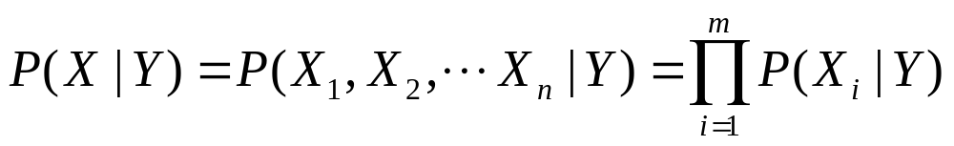
Naïve Bayesian Categorization
If we assume features of an instance are independent given the category (conditionally independent).
Therefore, we then only need to know P(X_{i} | Y) for each possible pair of a feature-value and a category.
If Y and all X_{i} and binary, this requires specifying only 2n parameters:
  P(X_{i}=true | Y=true) and P(X_{i}=true | Y=false) for each X_{i}
  P(X_{i}=false | Y) = 1 – P(X_{i}=true | Y)
Compared to specifying 2^{n} parameters without any independence assumptions.

Slide 18
Naïve Bayes Categrization Example
Probability | positive | negative
P(Y) | 0.5 | 0.5
P(small | Y) | 0.4 | 0.4
P(medium | Y) | 0.1 | 0.2
P(large | Y) | 0.5 | 0.4
P(red | Y) | 0.9 | 0.3
P(blue | Y) | 0.05 | 0.3
P(green | Y) | 0.05 | 0.4
P(square | Y) | 0.05 | 0.4
P(triangle | Y) | 0.05 | 0.3
P(circle | Y) | 0.9 | 0.3
Test Instance:
<medium ,red, circle>

Slide 19
Naïve Bayes Categorization Example
Probability | positive | negative
P(Y) | 0.5 | 0.5
P(medium | Y) | 0.1 | 0.2
P(red | Y) | 0.9 | 0.3
P(circle | Y) | 0.9 | 0.3
Test Instance:
<medium ,red, circle>
P(positive | X) = P(positive)*P(medium | positive)*P(red | positive)*P(circle | positive) / P(X)
0.5 * 0.1 * 0.9 * 0.9
= 0.0405 / P(X)
= 0.0405 / 0.0495 = 0.8181
P(negative | X) = P(negative)*P(medium | negative)*P(red | negative)*P(circle | negative) / P(X)
0.5 * 0.2 * 0.3 * 0.3
= 0.009 / P(X)
= 0.009 / 0.0495 = 0.1818
P(positive | X) + P(negative | X) = 0.0405 / P(X) + 0.009 / P(X) = 1
P(X) = (0.0405 + 0.009) = 0.0495

Slide 20
Naïve Bayes Diagnosis Example
C = {allergy, cold, well}
e₁ = sneeze; e₂ = cough; e₃ = fever
E = {sneeze, cough, ¬fever}
Prob | Well | Cold | Allergy
P(c_{i}) | 0.9 | 0.05 | 0.05
P(sneeze|c_{i}) | 0.1 | 0.9 | 0.9
P(cough|c_{i}) | 0.1 | 0.8 | 0.7
P(fever|c_{i}) | 0.01 | 0.7 | 0.4

Slide 21
Naïve Bayes Diagnosis Example (cont.)
P(well | E) = (0.9)(0.1)(0.1)(0.99)/P(E)=0.0089/P(E)
P(cold | E) = (0.05)(0.9)(0.8)(0.3)/P(E)=0.01/P(E)
P(allergy | E) = (0.05)(0.9)(0.7)(0.6)/P(E)=0.019/P(E)
Most probable category: allergy
P(E) = 0.0089 + 0.01 + 0.019 = 0.0379
P(well | E) = 0.23
P(cold | E) = 0.26
P(allergy | E) = 0.50
Probability | Well | Cold | Allergy
P(c_{i}) | 0.9 | 0.05 | 0.05
P(sneeze | c_{i}) | 0.1 | 0.9 | 0.9
P(cough | c_{i}) | 0.1 | 0.8 | 0.7
P(fever | c_{i}) | 0.01 | 0.7 | 0.4
E={sneeze, cough, ¬fever}

Slide 22
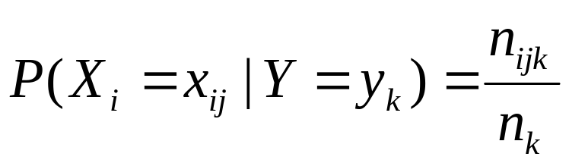
Estimating Probabilities
Normally, probabilities are estimated based on observed frequencies in the training data.
If D contains n_{k} examples in category y_{k}, and n_{ijk} of these n_{k} examples have the jth value for feature X_{i}, x_{ij}, then:
However, estimating such probabilities from small training sets is error-prone.
If due only to chance, a rare feature, X_{i}, is always false in the training data, ∀y_{k} :P(X_{i}=true | Y=y_{k}) = 0.
If X_{i}=true then occurs in a test example, X, the result is that ∀y_{k}: P(X | Y=y_{k}) = 0 and ∀y_{k}: P(Y=y_{k} | X) = 0

Slide 23
Probability Estimation Example
Probability | positive | negative
P(Y) | 0.5 | 0.5
P(small | Y) | 0.5 | 0.5
P(medium | Y) | 0.0 | 0.0
P(large | Y) | 0.5 | 0.5
P(red | Y) | 1.0 | 0.5
P(blue | Y) | 0.0 | 0.5
P(green | Y) | 0.0 | 0.0
P(square | Y) | 0.0 | 0.0
P(triangle | Y) | 0.0 | 0.5
P(circle | Y) | 1.0 | 0.5
Ex | Size | Color | Shape | Category
1 | small | red | circle | positive
2 | large | red | circle | positive
3 | small | red | triangle | negitive
4 | large | blue | circle | negitive
Test Instance X:
<medium, red, circle>
P(positive | X) = 0.5 * 0.0 * 1.0 * 1.0 / P(X) = 0
P(negative | X) = 0.5 * 0.0 * 0.5 * 0.5 / P(X) = 0

Slide 24
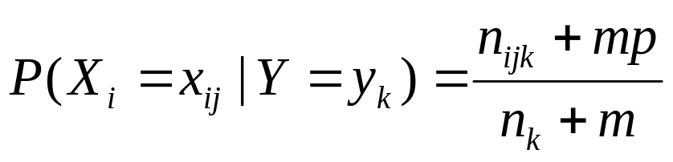
Smoothing
To account for estimation from small samples, probability estimates are adjusted or smoothed.
Laplace smoothing using an m-estimate assumes that each feature is given a prior probability, p, that is assumed to have been previously observed in a “virtual” sample of size m.
For binary features, p is simply assumed to be 0.5.

Slide 25
Laplace Smothing Example
Assume training set contains 10 positive examples:
  4: small
  0: medium
  6: large
Estimate parameters as follows (if m=1, p=1/3)
  P(small | positive) = (4 + 1/3) / (10 + 1) = 0.394
  P(medium | positive) = (0 + 1/3) / (10 + 1) = 0.03
  P(large | positive) = (6 + 1/3) / (10 + 1) = 0.576
  P(small or medium or large | positive) = 1.0

Slide 26
Text Categorization Applications
Web pages
  Recommending
  Yahoo-like classification
Newsgroup/Blog Messages
  Recommending
  spam filtering
  Sentiment analysis for marketing
News articles
  Personalized newspaper
Email messages
  Routing
  Prioritizing
  Folderizing
  spam filtering
  Advertising on Gmail

Slide 27
Text Categorization Methods
Most common representation of a document is a “bag of words,” i.e. set of words with their frequencies, word order is ignored.
Gives a high-dimensional vector representation (one feature for each word).
Vectors are sparse since most words are rare.
  Zipf’s law and heavy-tailed distributions

Slide 28
Naïve Bayes for Text
Modeled as generating a bag of words for a document in a given category by repeatedly sampling with replacement from a vocabulary V = {w₁, w₂,…w_{m}} based on the probabilities P(w_{j} | c_{i}).
Smooth probability estimates with Laplace m-estimates assuming a uniform distribution over all words (p = 1/|V|) and m = |V|
  Equivalent to a virtual sample of seeing each word in each category exactly once.

Slide 29
Naïve Bayes Generative Model for Text
spam
legit
spam
spam
legit
legit
spam
spam
legit
Category
Viagra
science
win
PM
!!
hot
!!
hot
!
computer
Friday
Nigeria
deal
deal
test
homework
lottery
nude
March
score
Viagra
!
Viagra
May
$
exam
spam
legit

Slide 30
Naïve Bayes Text Classification
Win lotttery $ !
?? ??
spam
legit
spam
spam
legit
legit
spam
spam
legit
Viagra
science
Category
win
PM
hot
!!
computer
Friday
Nigeria
!
deal
test
homework
lottery
nude
March
score
!
Viagra
May
$
exam
spam
legit

Slide 31
Text Naïve Bayes Algorithm
(Train)
Let V be the vocabulary of all words in the documents in D
For each category c_{i} ∈ C
Let D_{i} be the subset of documents in D in category c_{i}
P(c_{i}) = |D_{i}| / |D|
Let T_{i} be the concatenation of all the documents in D_{i}
Let n_{i} be the total number of word occurrences in T_{i}
For each word w_{j} ∈ V
Let n_{ij} be the number of occurrences of w_{j} in T_{i}
Let P(w_{j} | c_{i}) = (n_{ij} + 1) / (n_{i} + |V|)

Slide 32
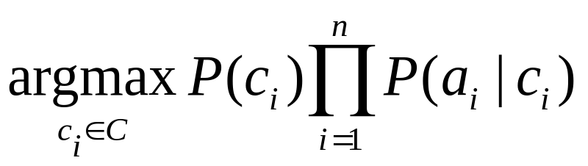
Text Naïve Bayes Algorithm
(Test)
Given a test document X
Let n be the number of word occurrences in X
Return the category:
where a_{i} is the word occurring the ith position in X

Slide 33
Underflow Prevention
Multiplying lots of probabilities, which are between 0 and 1 by definition, can result in floating-point underflow.
Since log(xy) = log(x) + log(y), it is better to perform all computations by summing logs of probabilities rather than multiplying probabilities.
Class with highest final un-normalized log probability score is still the most probable.

Slide 34
Comments on Naïve Bayes
Makes probabilistic inference tractable by making a strong assumption of conditional independence.
Tends to work fairly well despite this strong assumption.
Experiments show it to be quite competitive with other classification methods on standard datasets.
Particularly popular for text categorization, e.g. spam filtering.

